Slide 1
Physical Education
New national curriculum Frame work and Sport Premium Funding

Slide 2
Changes to Physical Education
National Curriculum
Sports Premium Funding
Ofsted

Slide 3
Changes to the National curriculum
Focus on how physically active children are for long periods of time
Focus on leading active and healthy lives
Focus on competition
KS1 Focus on Fundamental Skills
KS2 focus on team skills and collaboration
Ability to swim 25 metres
Reduction in subject content within document

Slide 4
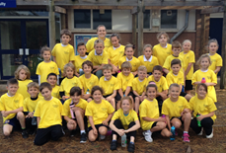
How these changes are being addressed
Restructure of PE year time table
Collaboration and teamwork within games
Fundamental Skills
Increasing the number of clubs available to children
Monitoring the children that attend clubs and have accessed competition

Slide 5
Sports Premium Funding
Every Primary School have been given funding to
Expand school games and run sports competitions or increase pupils participation in school games
Support the least active children through clubs and the Change For Life programme
Provide resources for Physical Education and training for staff

Slide 6
Impact on Cheddar Grove
During the academic year of 2013-2014 the school will receive £9735 to be spent of improving Physical Education.

Slide 7
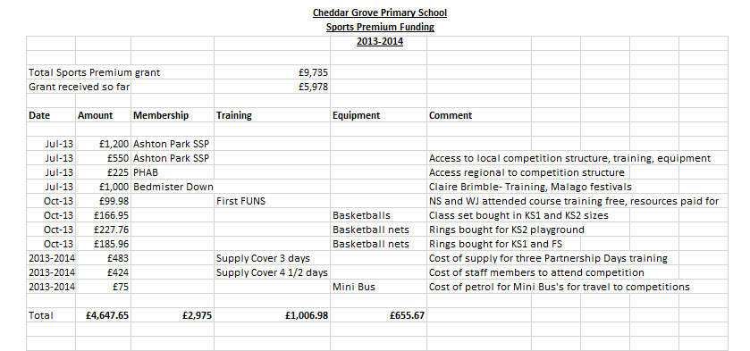
Funding expenditure to date

Slide 8
Funding expenditure to date
Membership to Ashton Park SSP- £1750
Membership to PHAB
Membership to Bedminster Down sports service
Training
Equipment
Notes:
Membership to Ashton Park SSP- competition at a local level, training opportunities, loan resources and equipment
Membership to PHAB- Primary Heads Association Bristol- competition at level 2-city wide network has links to YST and to Wesport
Allocation of Claire Brimble to support in school with CPD/organise competitions/festivals. Use of young leaders YR 10 for our clubs and festivals
CPD opportunities through course/partnership days/ supply cover for staff to attend competitions
To inspire children and to participate in new sports

Slide 9
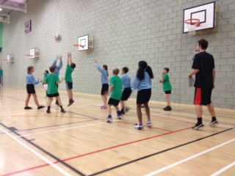
Effects of funding
Professional Development opportunities to improve teaching
Competitions
Clubs
Resources
Notes:
Professional Development
MEMBERSHIP-Partnership days,
First FUNS,
Whole staff training Basketball,
NQT training with CB, CB training year 2 teachers in prep for dance festival
Supply cover to attend sport specific course- tennis 3 staff members-
Gymnastics CPD at BD with CB for Year 3 teachers
Competitions
MEMBERSHIP- 9 Ashton Park and PHAB events competitions so far this year which has involved over 100 children
Knock on effect through selection so over 50 children have taken part in House Competitions
60 children have attended festivals
Clubs- Release time
Support from young leaders at Bedminster Down
Resources
Bought and borrowed form partnership kit to support the teaching of PE

Slide 10
Accountability
Ofsted
Funding should improve the quality and breath of school provision, including increasing participation in PE and sport so that pupil develop healthy lifestyles - Ofsted September 2013
Website
Notes:
Ofsted
Monitor how effectively it is being used through discussions with SLT, lesson observations of curricular lessons and extra curricular activities, talking with governors and pupils
Website
By April 2014 the school must publish on their website how they are going to spend the money. This must include how much/how its been spent and the impact the school has seen on pupils PE and sport participation and attainment, to help ensure that all pupils develop healthy lifestyles HEALTHY ME CLUB/DRAMA

Slide 11
Future planning and next steps
Teaching and learning
Adapt the way we teach PE to ensure pupils are always active
Revise the planning to ensure that there is clear progression
Look at monitoring and assessment of PE
Ensure sustainability
Sports Premium Funding
Target groups of children who are less likely to attend club/are the least physically active
Increase the amount of clubs available for KS1 pupils
Assess the membership that we have to SSP/BD/PHAB
Gain a Kite Mark award
Organise a Youth Games festival

